Slide 1
Lecture 7
Policy Gradient Algorithms
B. Ravindran

Slide 2
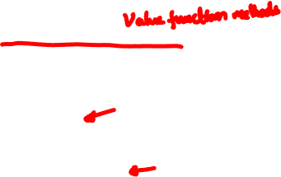

Solution Methods
Temporal Difference Methods
TD(λ)
Q-learning
SARSA
Actor-Critic
Policy Search
Policy Gradient Methods
Evolutionary algorithms
Model based methods
Stochastic Dynamic Programming
Bayesian approaches

Slide 3
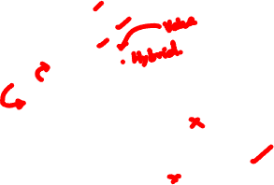
Solution Methods
Temporal Difference Methods
TD(λ)
Q-learning
SARSA
Actor-Critic
Policy Search
Policy Gradient Methods
Evolutionary algorithms
Model based methods
Stochastic Dynamic Programming
Bayesian approaches

Slide 4
Solution Methods
Temporal Difference Methods
TD(λ)
Q-learning
SARSA
Actor-Critic
Policy Search
Policy Gradient Methods
Evolutionary algorithms
Model based methods
Stochastic Dynamic Programming
Bayesian approaches

Slide 5
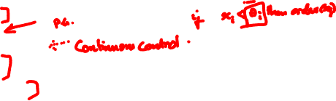
Policy Search Methods
Policy search: Instead of maintaining estimates of value functions, search in the space of policies
Why?
Simpler description
Better convergence
Robust to partial observability
Direct policy search
Genetic algorithms
Policy Gradient Approaches
Notes:
e.g. for simpler form: Threshold policies for inventory control.
e.g. for well behaved policy gradient methods with function approx: You can view the weights of a neural network as the parameters of the policy and under mild regularity conditions, they can be shown to converge.

Slide 6
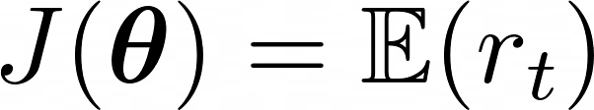
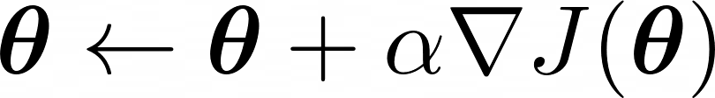
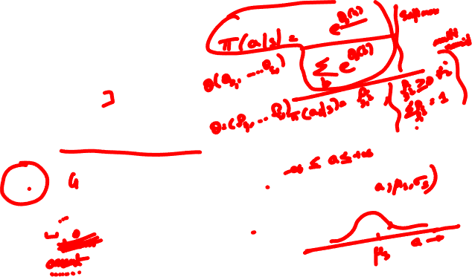
Policy Gradient Methods
Policy depends on some parameters θ
Action preferences
Mean and variance
Weights of a neural network
Idea: Modify policy parameters directly instead of estimating the action values
Maximize:
θ update:
Simplified Setting
Immediate Reward or
Multi-arm bandits

Slide 7


Multi-Armed Bandit
n-arm bandit problem is to learn to preferentially select a particular action (arm) from a set of n actions (1, 2, 3, . . . . , n)
Each selection results in Rewards, with noise
Sometimes you get a reward, sometimes don’t
Pick arm that has the highest expected reward
Notes:
skipped

Slide 8
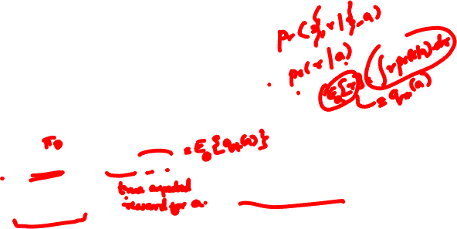
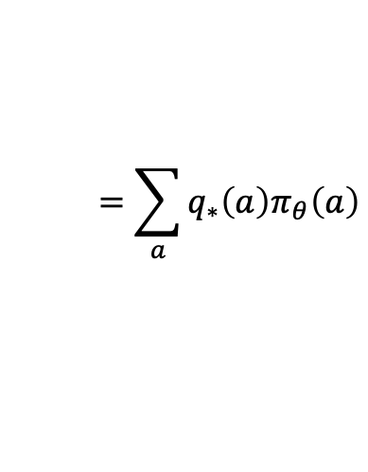
Policy Gradient Methods
Policy depends on some parameters θ
Action preferences
Mean and variance
Weights of a neural network
Idea: Modify policy parameters directly instead of estimating the action values
Maximize:
θ update:
$$=\sum_{a}{q_{∗}\left(a\right)π_{θ}\left(a\right)}$$
Simplified Setting
Immediate Reward or
Multi-arm bandits
Notes:
skipped

Slide 9
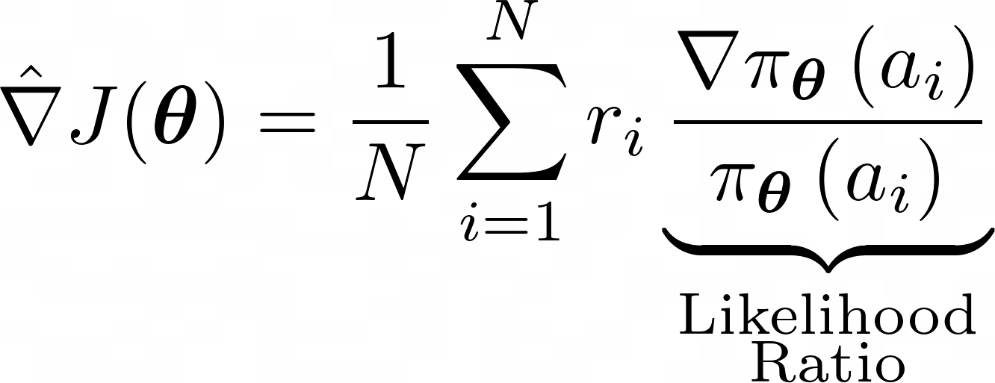
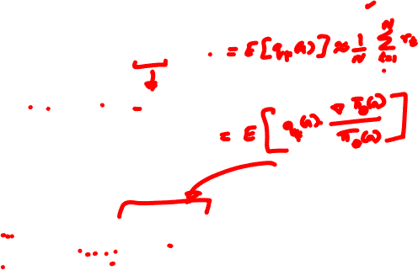
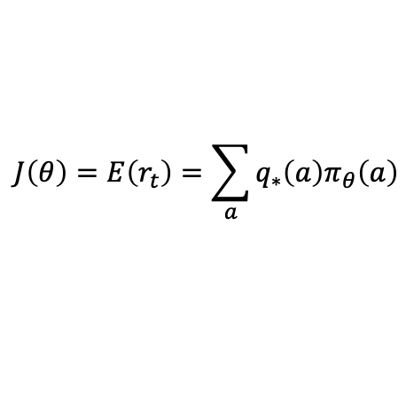
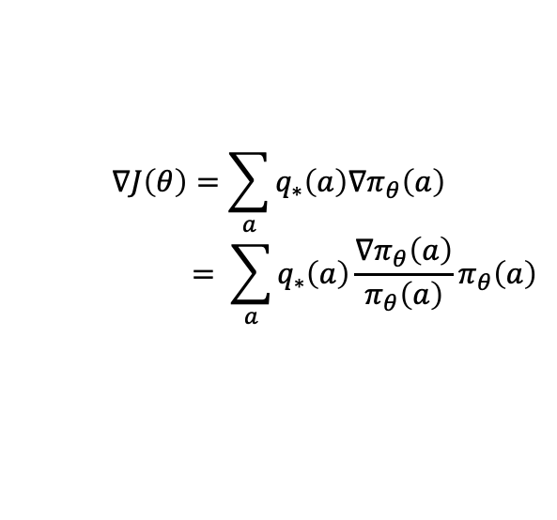
Stochastic Gradient Descent
We compute the gradient of the performance J(θ) w.r.t the parameters θ
$$J\left(θ\right)=E\left(r_{t}\right)=\sum_{a}{q_{∗}\left(a\right)π_{θ}\left(a\right)}$$
$$∇J\left(θ\right)=\sum_{a}{q_{∗}\left(a\right){∇π}_{θ}\left(a\right)}$$
$$= \sum_{a}{q_{∗}\left(a\right)\frac{{∇π}_{θ}\left(a\right)}{π_{θ}\left(a\right)}π_{θ}\left(a\right)}$$
Estimate the gradient from N samples
Notes:
In Chapter 2 we took a brief look at a policy gradient approach for non-associative problems, like the n-armed bandit task. Here is a brief recap of that.
Gradient expression related to importance sampling
Gradient estimate is an unbiased estimate

Slide 10
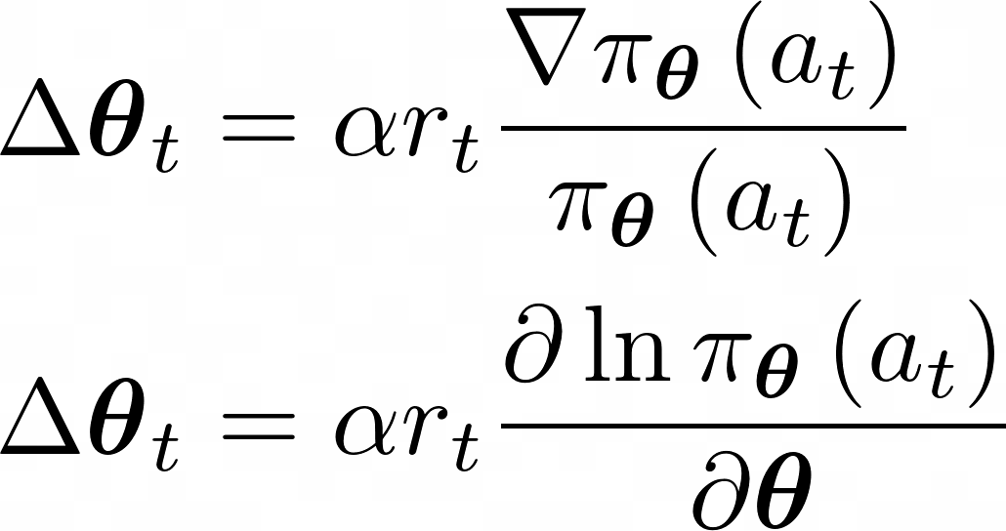
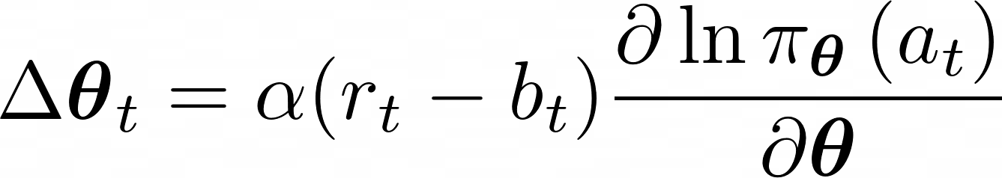
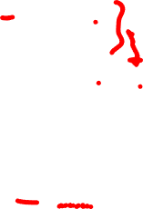
REINFORCE (Williams ‘92)
Incremental version
REINFORCE with baseline
Reinforcement Baseline
Characteristic Eligibility

Slide 11

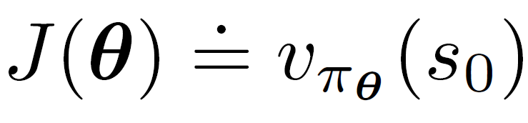
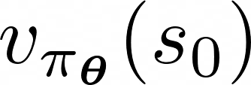

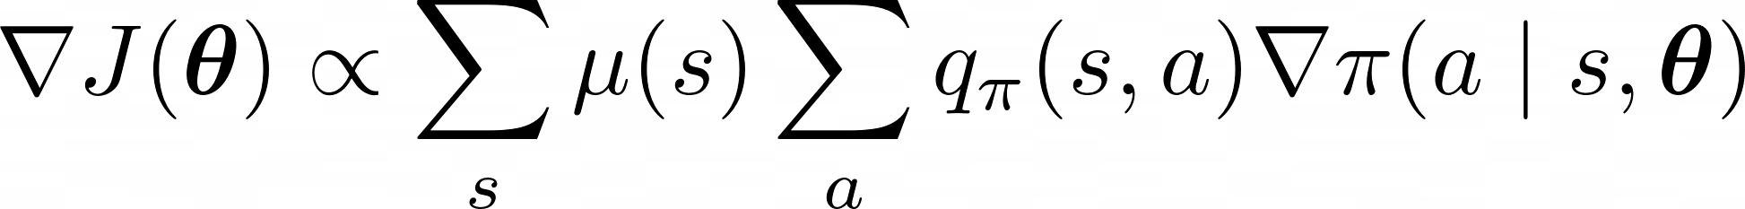
Policy Gradient Theorem
In the episodic case, we define the performance by assuming that every episode starts from state (non-random), as follows:
where is the true value function given a parameterized policy
The Policy Gradient Theorem: The gradient of the performance can be expressed in terms of the gradient of the policy, as follows

Slide 12
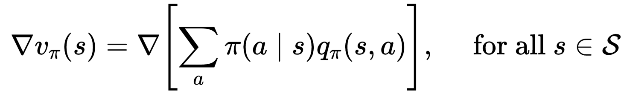
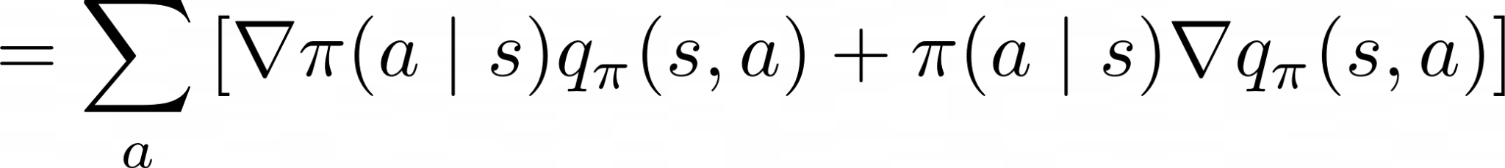
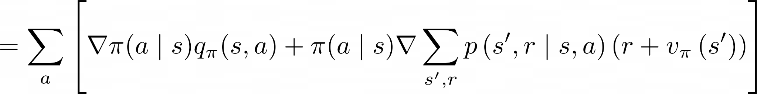
Policy Gradient Theorem
The policy gradient theorem provides an analytic expression for the gradient of performance with respect to the policy parameter θ
We begin the proof by expressing the gradient of the state-value function in terms of the action-value function

Slide 13
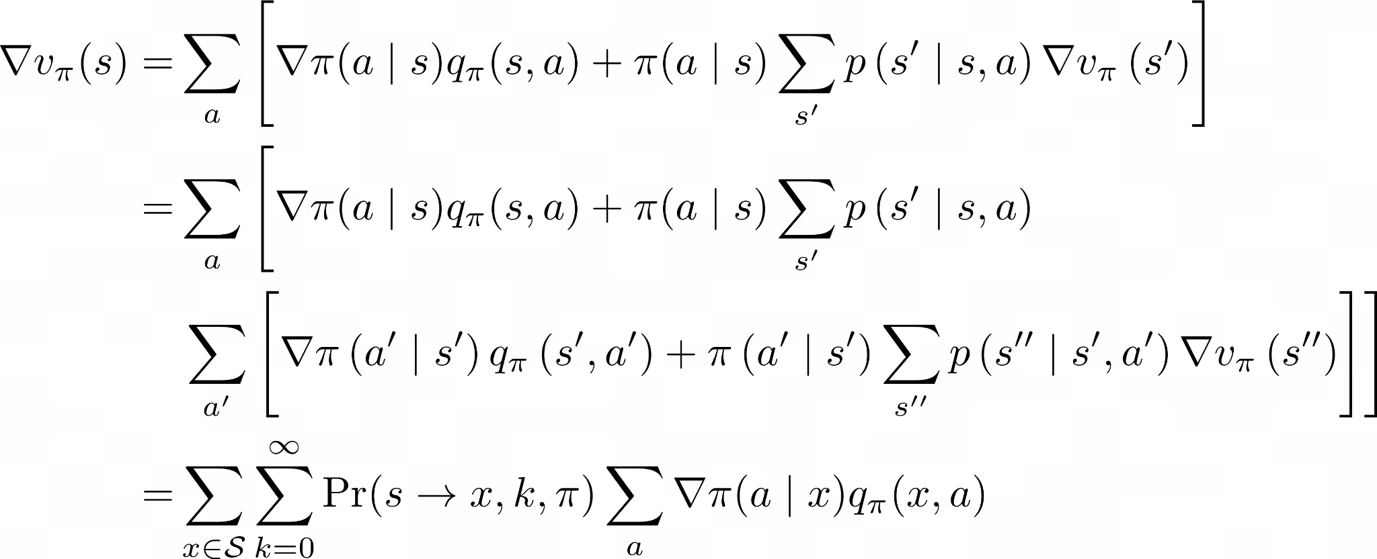

Policy Gradient Theorem: Proof
is the probability of transitioning from state s to state x in k steps under policy π

Slide 14
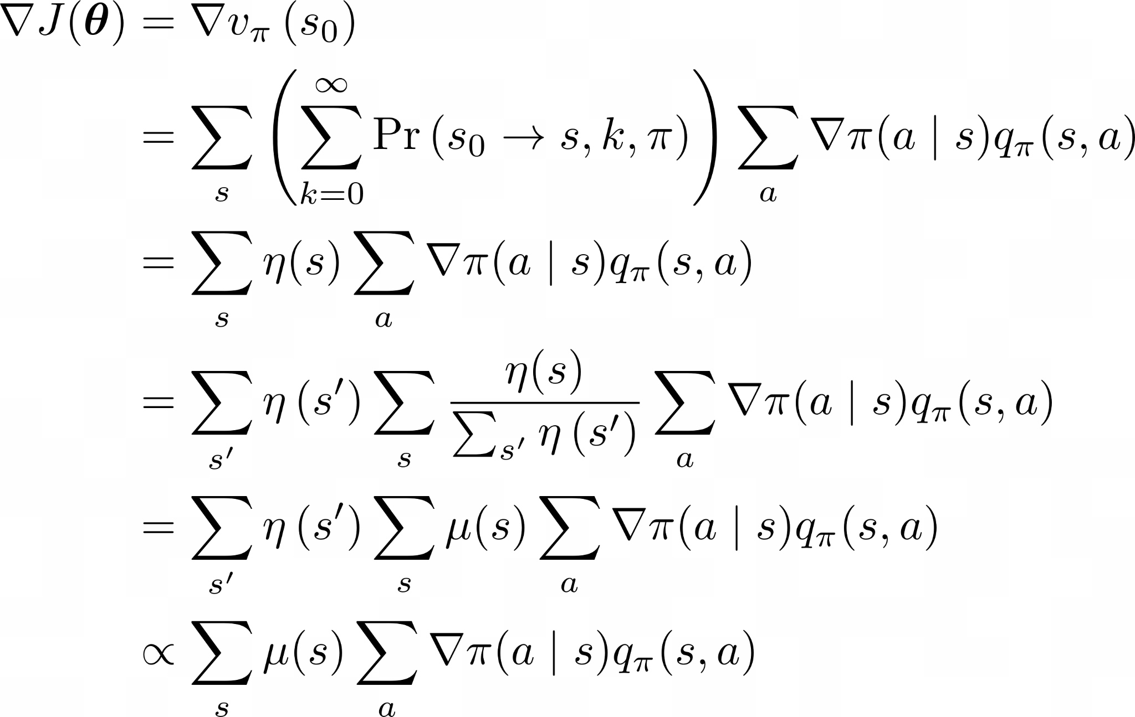
Policy Gradient Theorem: Proof (contd.)

Slide 15
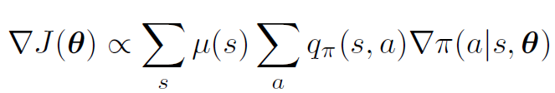
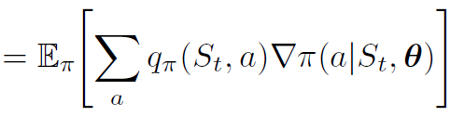
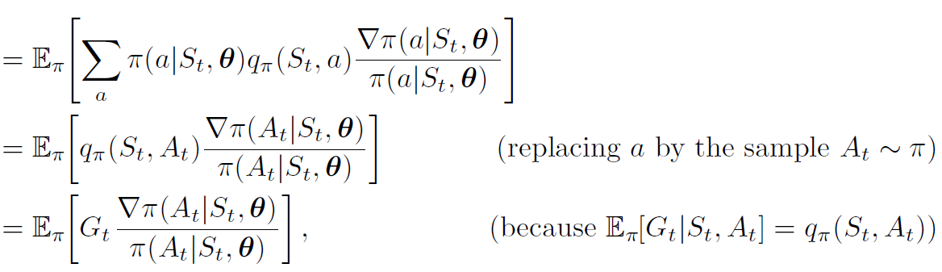
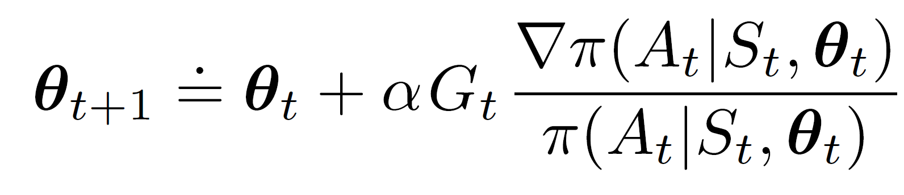
REINFORCE: MC Policy Gradient
Uses the complete return from time t, which includes all
future rewards up until the end of the episode

Slide 16
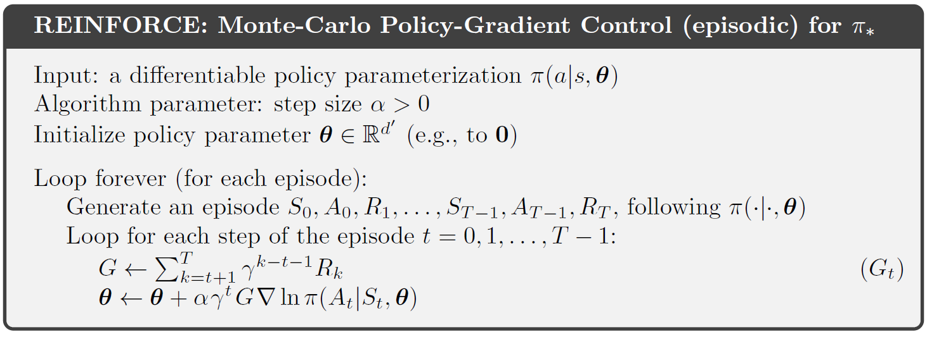
REINFORCE: MC Policy Gradient Algorithm
The algorithm computes an unbiased estimate of the gradient
Can be very slow due to high variance in the estimates
Variance is related to the “recurrence time" or the episode length
For problems with large state spaces, the variance becomes unacceptably high.
Notes:
This slide or the next slide?

Slide 17
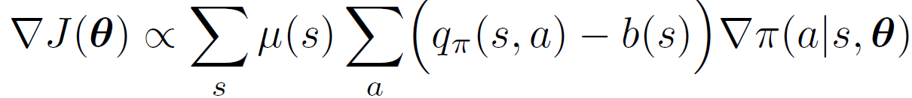
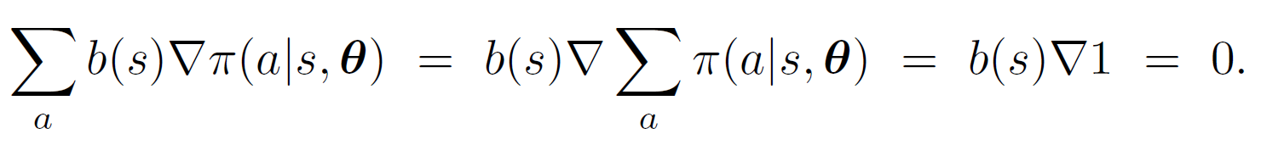
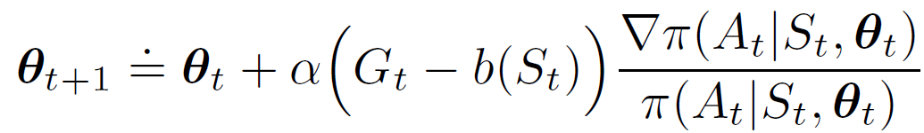
REINFORCE: With Baseline
The policy gradient theorem can be generalized to include a comparison of the action value to an arbitrary baseline b(s)
The baseline should be a function (or a random variable) that does not depend on the action a, in which case, the subtracted quantity is 0
Update rule of REINFORCE with baseline
Doesn’t change the expected value, but has an effect on the variance

Slide 18
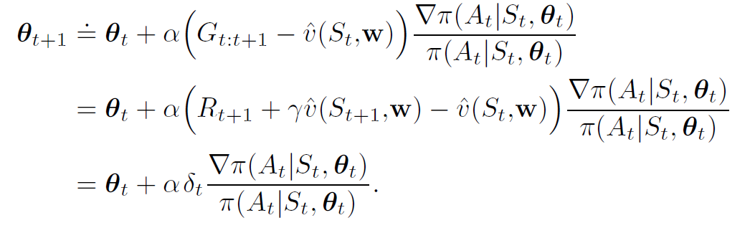
Actor-Critic Methods
Actor-Critic methods learn both a policy and a state-value function simultaneously.
The policy is referred to as the actor that suggests actions given a state.
The estimated value function is referred to as the critic. It evaluates actions taken by the actor based on the given policy.

Slide 19
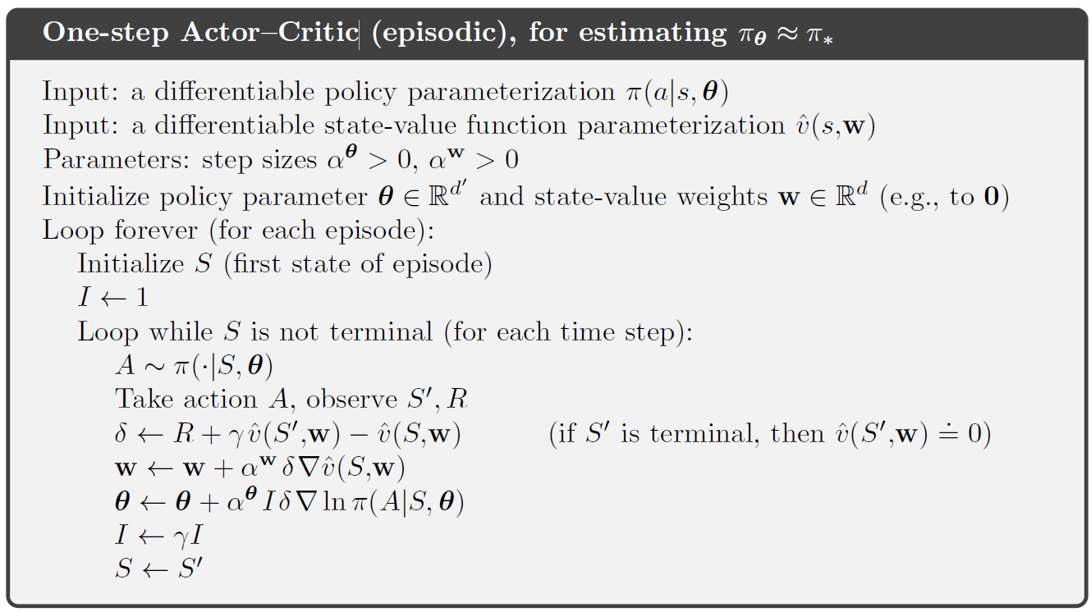
One-step Actor-Critic Algorithm

Slide 20
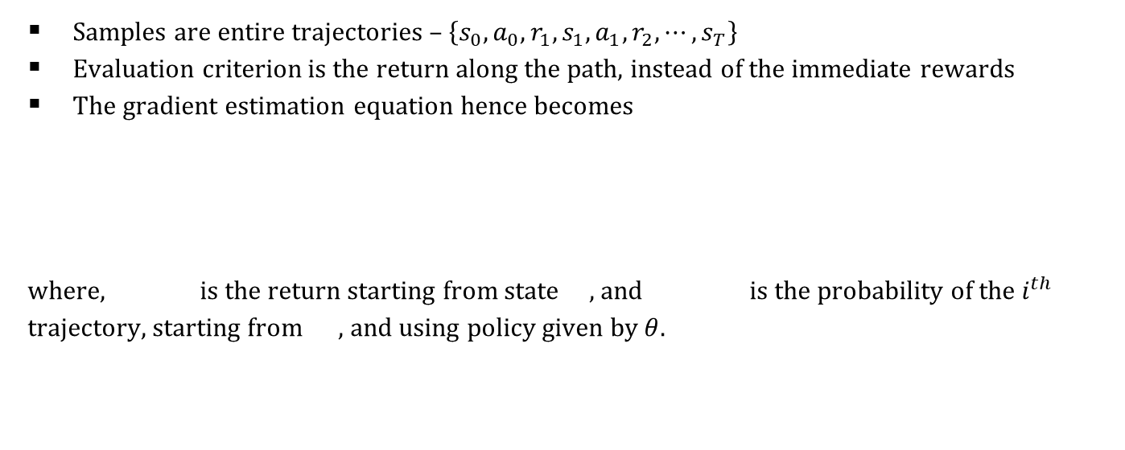
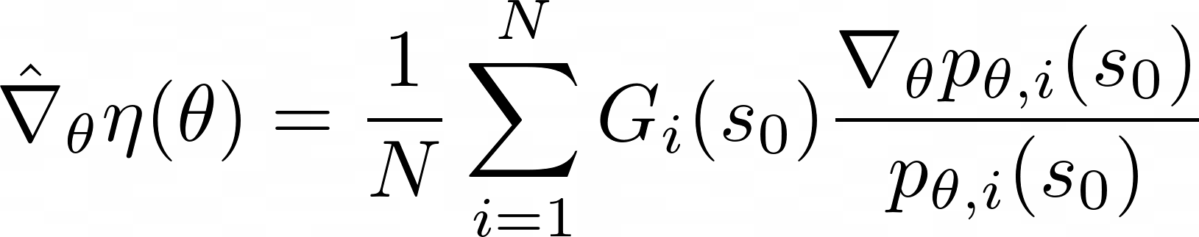
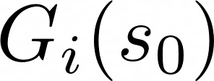

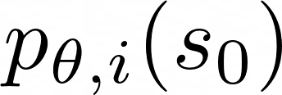
Monte-Carlo Policy Gradient

Slide 21
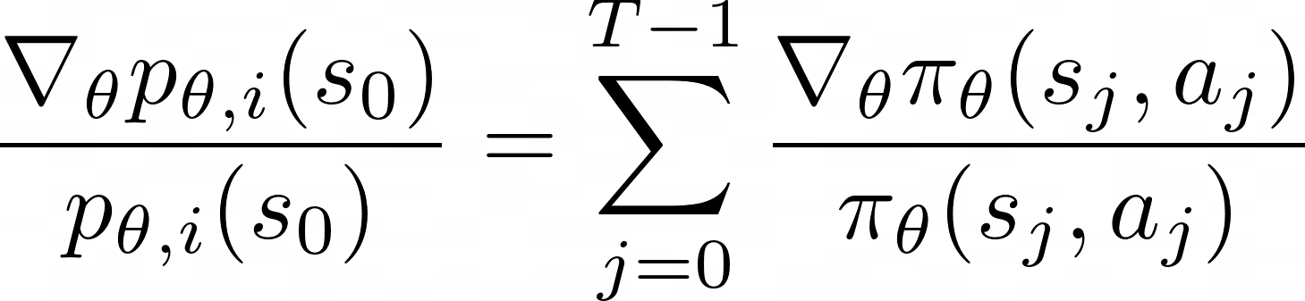
Monte-Carlo Policy Gradient (contd.)
The “likelihood ratio" in this case evaluates to
The estimate depends on the starting state . One way to address this issue is to assume a fixed initial state
More common assumption is to use the average reward formulation

Slide 22
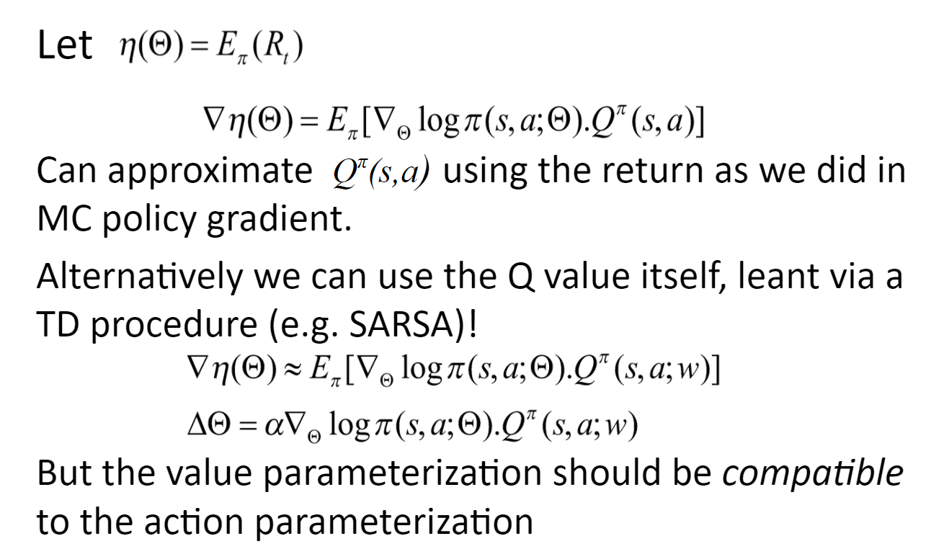
Policy Gradient Theorem

Slide 23
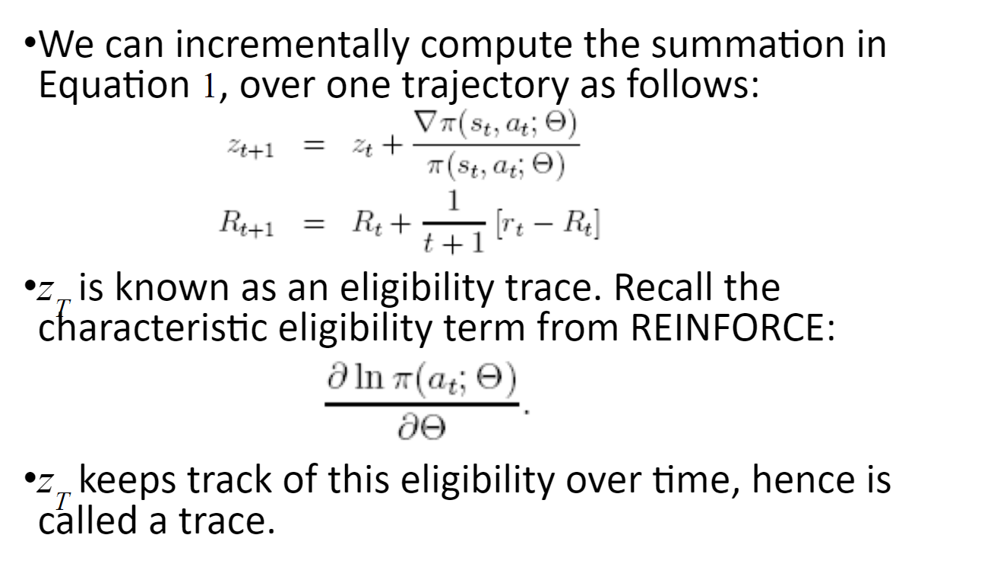
Incremental Update
Verify this slide before typing

Slide 24
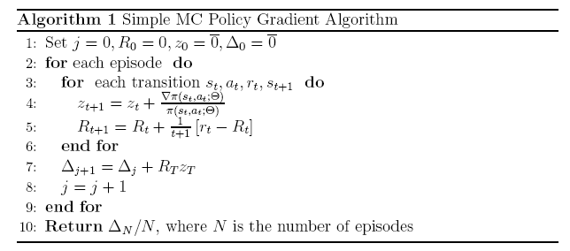
Simple MC Policy Gradient Algorithm
The algorithm computes an unbiased estimate of the gradient
Can be very slow due to high variance in the estimates
Variance is related to the “recurrence time" or the episode length
For problems with large state spaces, the variance becomes unacceptably high.
Notes:
Is this the same as REINFORCE: Monte Carlo?

Slide 25
Deterministic Policy Gradient (Not part of this lecture)
Problems with continuous action spaces
Hard to implement differentiable continuous controllers in many problems
Reduces the expectation to over only the states greatly simplifying the gradient estimation
Avoids max over actions
Key difficulty: What is the notion of gradient for deterministic policies?
Continuous action spaces allow us to think of change in actions w.r.t. policy parameter
Deterministic Policy Gradient Theorem
<equation>
Can be shown to be the limit of the Stochastic Policy Gradient Theorem in the limit the variance of the policy goes to zero
Exploration?
If the environment is stochastic then not an issue
Otherwise use off-policy actor-critic, where the behavior policy differs from the estimation policy
Q – learning for value function updates
Still require compatible parameterizations

